Slide 1
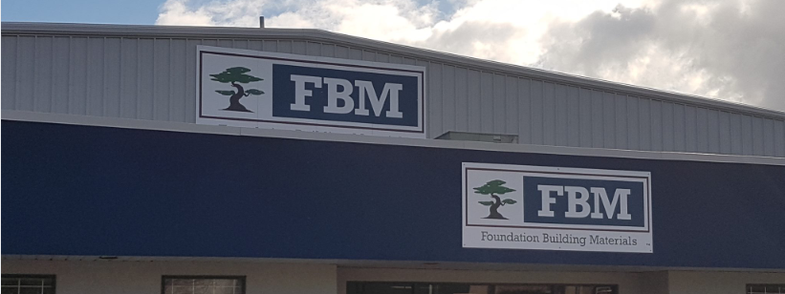

FBM Cost Update Process automation Case Study
August 2020

Slide 2



Use Case:
FBM receives vendor pricing sheet from their vendors every week.
There are more than 4000 items for which the cost update is done by an FBM resource manually.
They have a template for each vendor separately and cost update sheet with macro code in it.

Slide 3


AS-IS Process:
User opens saves the pricing sheet received from vendor through email in a separate location.
User copies data from pricing sheet and pastes in vendor template which creates a sheet with transpose data.
User copies the transpose data and pastes in cost update template sheet..
User executes macro in cost update sheet and sends to end user through email.

Slide 4


Business Challenge:
The data we are handling in this process are out FBM finance which is highly confidential and private, hence this process needs to be done without any discrepancies..
The process is completely repetitive, and judgements are made by human which increases the possibility of manual errors.

Slide 5


Process Flow – High Level
User copies pricing data and pastes in vendor template
User copies data from vendor template and pastes in cost update template.
Start
User receiver pricing sheet in email
End
User executes macro and send the sheet to end user.

Slide 6
Process Flow – Low Level
Start
For each email from vendor save the pricing sheet .
Stop
Copy the data from pricing sheet.
Send the macro sheet to end user through email
Paste it in vendor template.
Execute Macro
Copy the data in vendor template
Paste the data in cost update template

Slide 7
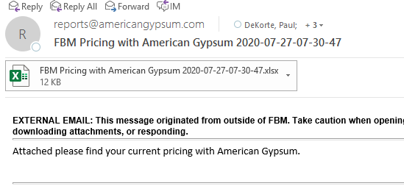
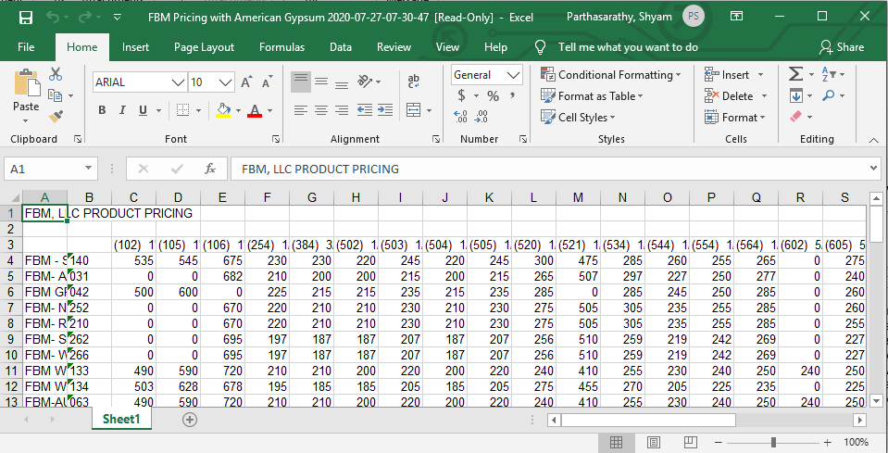
Step by Step Process:
Step 1: User saves the pricing sheet received from vendor through email.
Step 2: User copies data in pricing sheet.

Slide 8
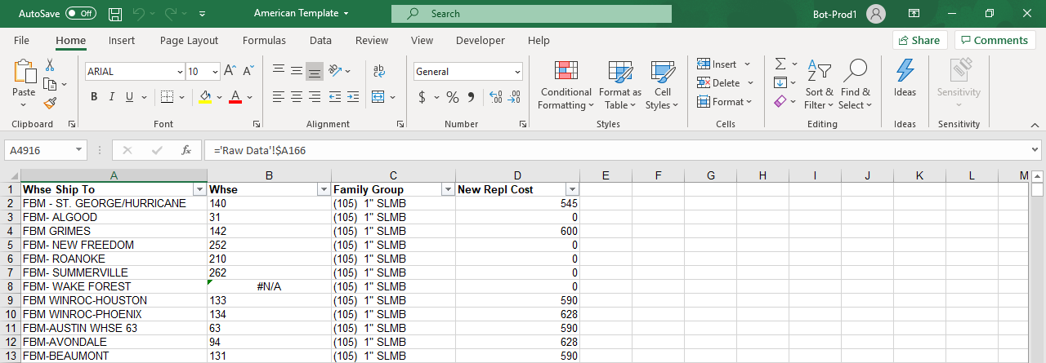
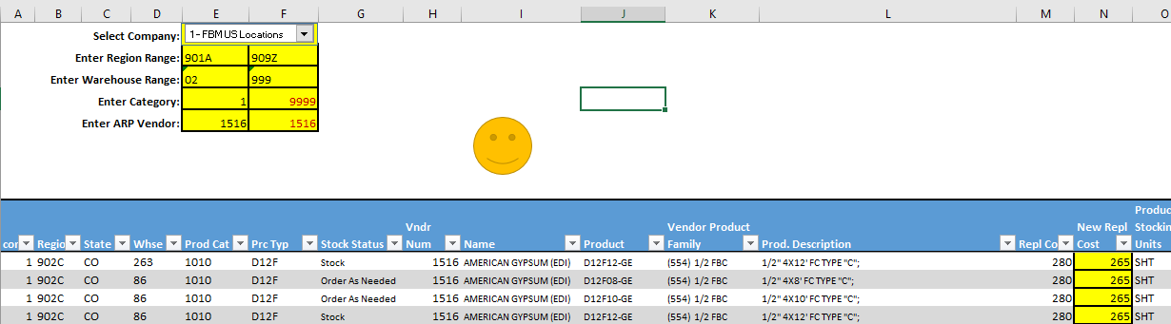
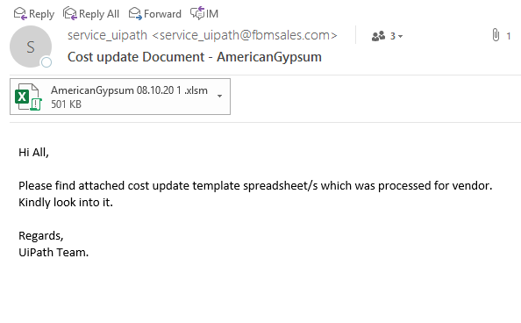
Step by Step Process:
Step 3: User pastes the data in vendor template which creates a transpose data in another sheet.
Step 4: User copies the transpose data.
Step 5: In User pastes the data in cost update template.
Step 6: User executes macro and sends the excel spreadsheet to end user through email..

Slide 9

Challenges Faced:
The ODBC drivers present in production are not as same as in test environment.
Filtering mails based on sender’s address and timing was a challenge as it was changing.
Execution of macro was continuously throwing an error due to data range.

Slide 10
Lessons Learnt:
The process has to be analyzed with the process owner to get a clear understanding and to get an idea of how to proceed this automation with RPA.
The code should be reviewed after development to make sure of its standards and appropriate logic
We should check for appropriate error handling techniques to develop a bug free code.

Slide 11
Benefits:
Time Take with Manual effort:
For 1 vendor cost update = 900 seconds/week (approximately) = 15 minutes/week
Time taken by Robot:
For 1 vendor = 90 seconds (approximately) = 1.5 minutes/ per week
Time saved per month for 1 vendor approximately = 54 minutes
Currently , the process is run for 1 vendor and the client is extending the same process for 25 vendors with some minor changes. This saves 1350 minutes (22.5 hours) per month.
The bot can work 24/7 without any break or errors which improves quality of the work and removes time constraint.
The bot can replace the human who is doing this time-consuming tedious job which is also cost and resource saving.

Slide 12
Thank You

